Slide 1

Macroeconomics
Sixth Canadian Edition
Chapter 5
A Closed-Economy One-Period Macroeconomic Model
Copyright © 2021 Pearson Canada Inc.
Notes:
If this PowerPoint presentation contains mathematical equations, you may need to check that your computer has the following installed:
1) MathType Plugin
2) Math Player (free versions available)
3) NVDA Reader (free versions available)

Slide 2
Chapter 5 Topics
Introduce the government.
Construct closed-economy one-period macroeconomic model, which has: (i) representative consumer; (ii) representative firm; (iii) government.
Economic efficiency and Pareto optimality.
Experiments: Increases in government spending and total factor productivity.
Consider a distorting tax on wage income and study the Laffer curve.
Extension of the basic model to include sticky wages and prices: a simple Keynesian model.

Slide 3
Closed-Economy One-Period Macro Model
Representative Consumer
Representative Firm
Competitive Equilibrium
Experiments: What does the model tell us are the effects of changes in government spending and in total factor productivity?

Slide 4

Figure 5.1 A Model Takes Exogenous Variables and Determines Endogenous Variables
Exogenous variables are determined outside a macroeconomic model. Given the exogenous variables, the model determines the endogenous variables. In experiments, we are interested in how the endogenous variables change when there are changes in exogenous variables.

Slide 5
Competitive Equilibrium
Representative consumer optimizes given market prices.
Representative firm optimizes given market prices.
The labour market clears.
The government budget constraint is satisfied, or G = T.

Slide 6

Income-Expenditure Identity
In a competitive equilibrium, the income-expenditure identity is satisfied, so
$$Y=C+G$$

Slide 7

The Production Function
$$Y=zF(K,N),$$

Slide 8
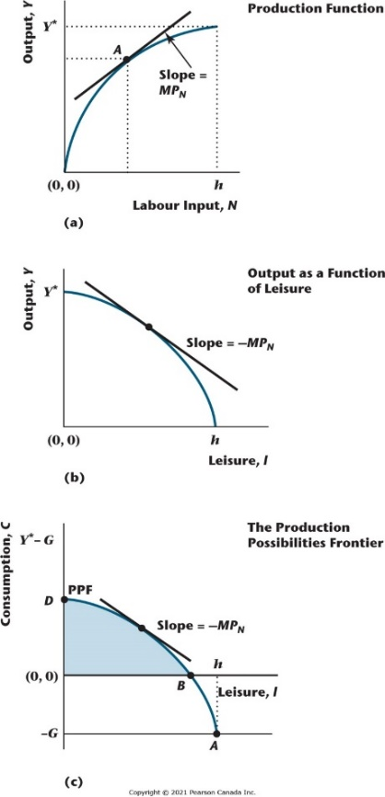
Figure 5.2 The Production Function and the Production Possibilities Frontier
Panel (a) shows the production function of the representative firm, while panel (b) shows the equilibrium relationship between the quantity of leisure consumed by the representative consumer and aggregate output. The relationship in (b) is the mirror image of the production function in (a). In (c), we show the production possibilities frontier (PPF), which is the technological relationship between C and l, determined by shifting the relationship in (b) down by the amount G. The shaded region in (c) represents consumption bundles that are technologically feasible to produce in this economy.

Slide 9
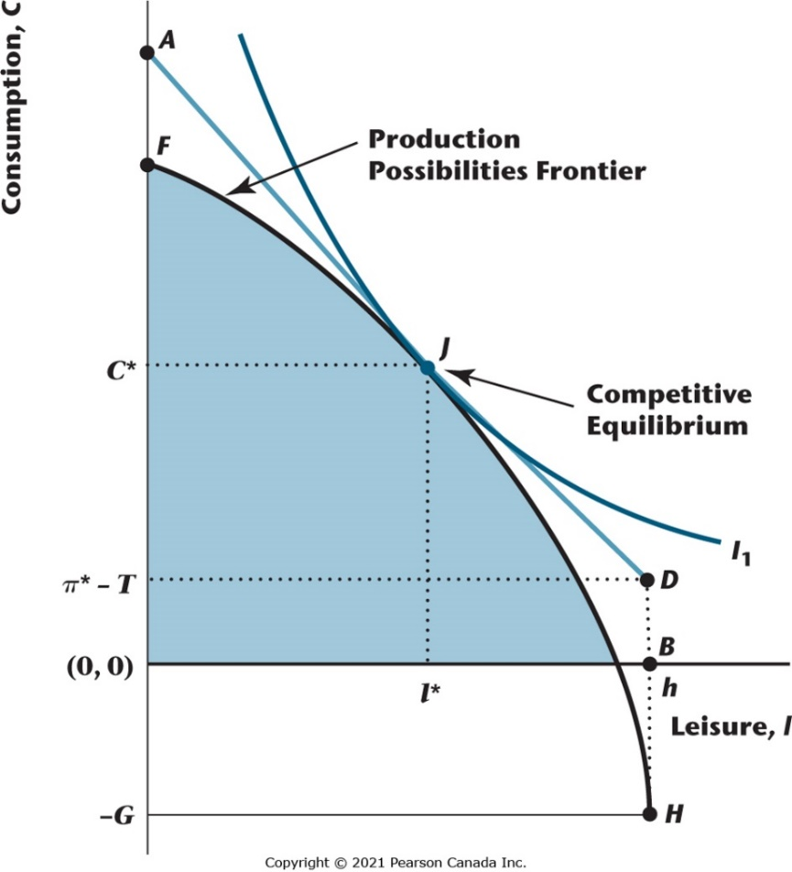
Figure 5.3 Competitive Equilibrium
This figure brings together the representative consumer’s preferences and the representative firm’s production technology to determine a competitive equilibrium. Point J represents the equilibrium consumption bundle. ADB is the budget constraint faced by the consumer in equilibrium, with the slope of AD equal to minus the real wage and the distance DB equal to dividend income minus taxes.

Slide 10

Key Properties of a Competitive Equilibrium
$$MRS_{l,c}=MRT_{l,c}=MP_{N′}$$

Slide 11
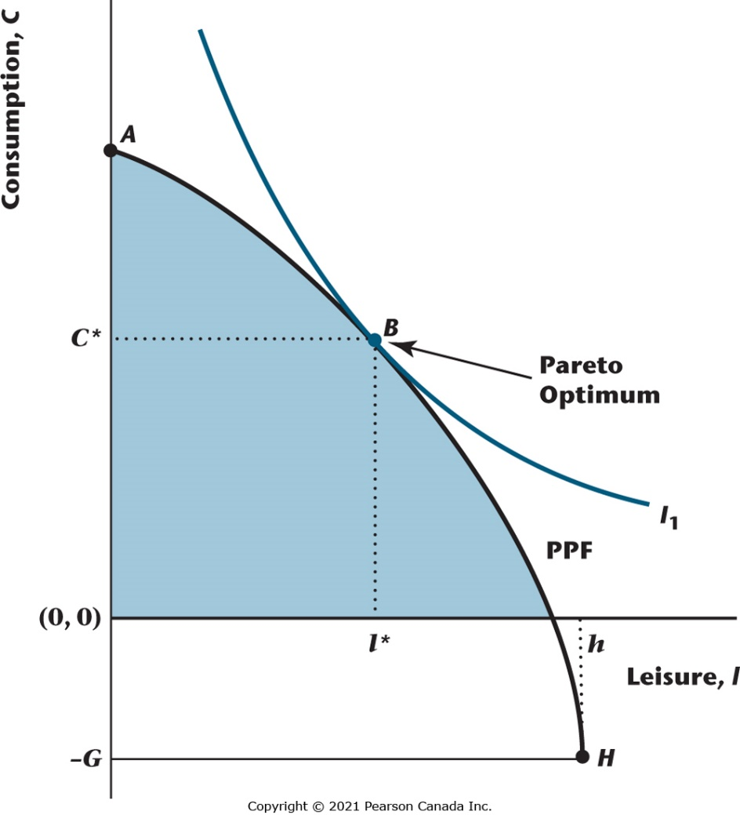
Figure 5.4 Pareto Optimality
The Pareto optimum is the point that a social planner would choose, where the representative consumer is as well off as possible given the technology for producing consumption goods by using labour as an input. Here, the Pareto optimum is B, where an indifference curve is tangent to the PPF.

Slide 12

Key Properties of a Pareto Optimum
In this model, the competitive equilibrium and the Pareto optimum are identical.
We know this as, at the Pareto optimum,
$$MRS_{l,c}=MRT_{l,c}=MP_{N′}$$

Slide 13
First and Second Welfare Theorems
These theorems apply to any macroeconomic model.
First Welfare Theorem: Under certain conditions, a competitive equilibrium is Pareto optimal.
Second Welfare Theorem: Under certain conditions, a Pareto optimum is a competitive equilibrium.

Slide 14
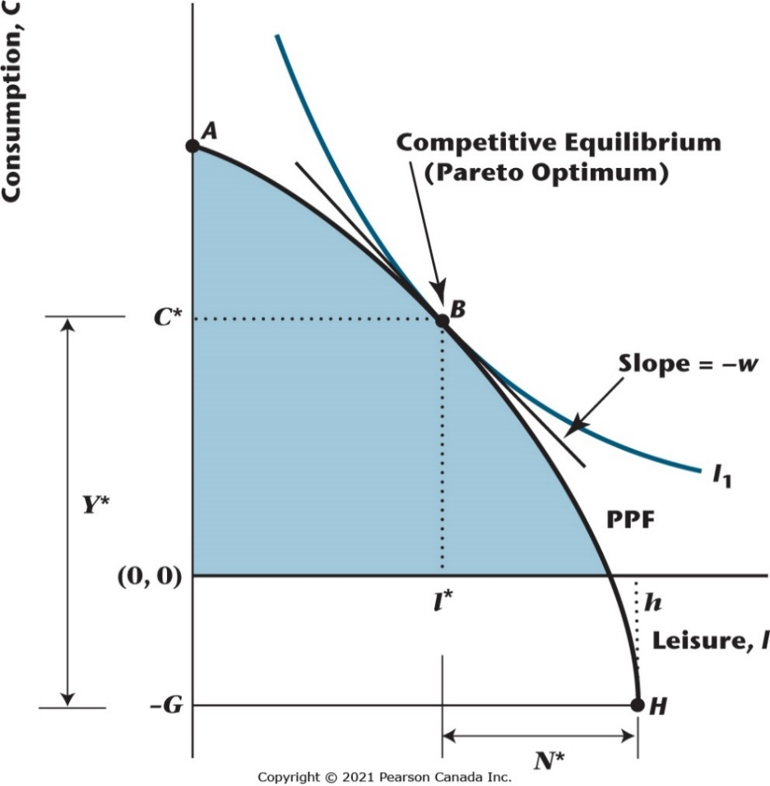
Figure 5.5 Using the Second Welfare Theorem to Determine a Competitive Equilibrium
Since the competitive equilibrium and the Pareto optimum are the same thing, we can analyze a competitive equilibrium by working out the Pareto optimum, which is point B in the figure. At the Pareto optimum, an indifference curve is tangent to the PPF, and the equilibrium real wage is equal to minus the slope of the PPF and minus the slope of the indifference curve at B.

Slide 15
Effects of an Increase in G
Essentially a pure income effect
C decreases, l decreases, Y increases, w falls

Slide 16
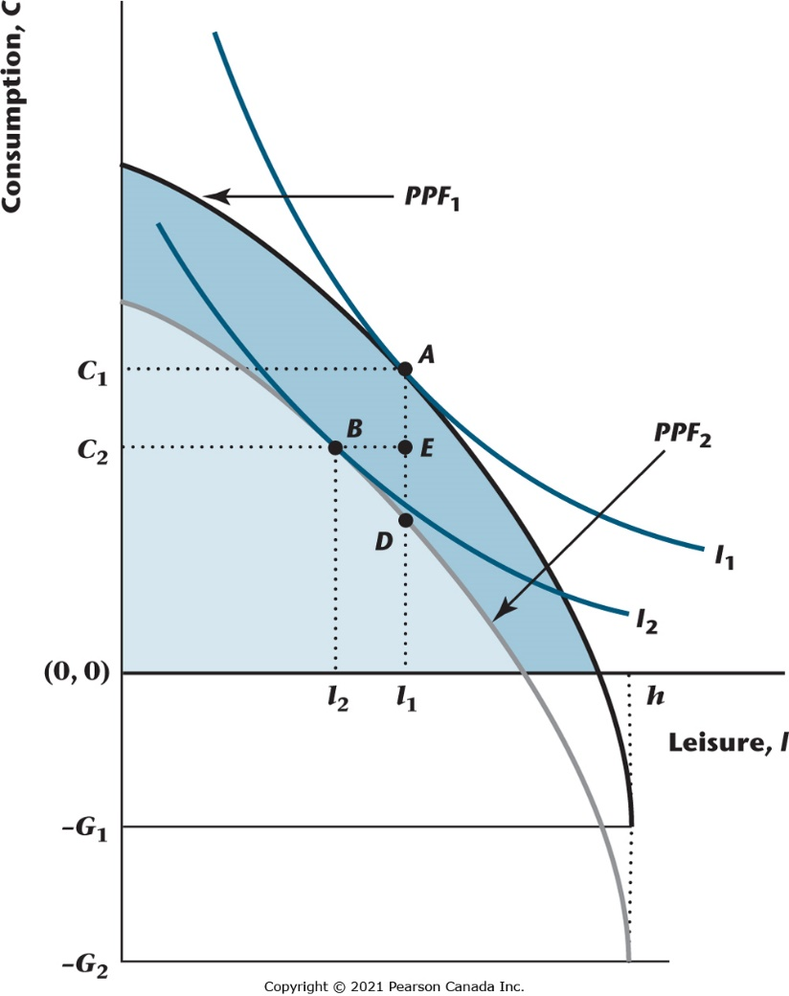
Figure 5.6 Equilibrium Effects of an Increase in Government Spending
An increase in government spending shifts the PPF down by the amount of the increase in G. There are negative income effects on consumption and leisure, so that both C and l fall, and employment rises, while output (equal to C + G) increases.

Slide 17
Effects of an Increase in z (or an increase in K)
PPF shifts out, and becomes steeper – income and substitution effects are involved.
C increases, l may increase or decrease, Y increases, w increases.

Slide 18
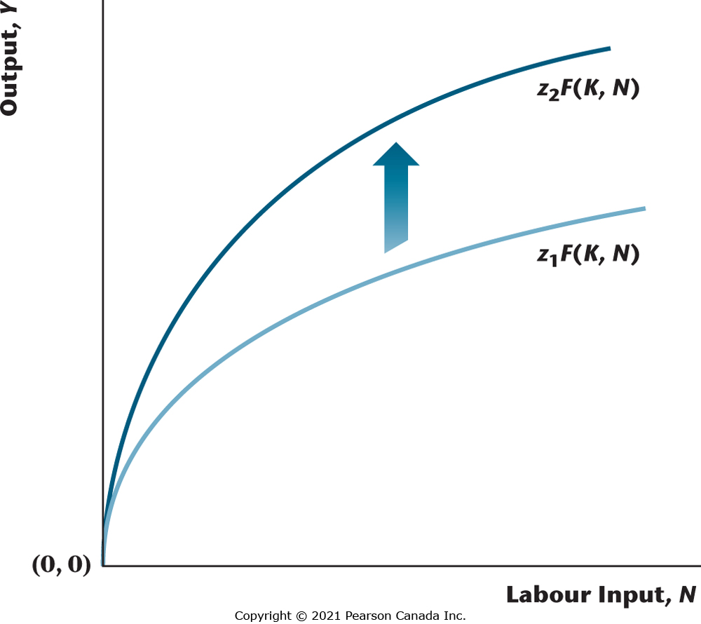
Figure 5.7 Increase in Total Factor Productivity
An increase in total factor productivity shifts the production function up and increases the marginal product of labour for each quantity of the labour input.

Slide 19
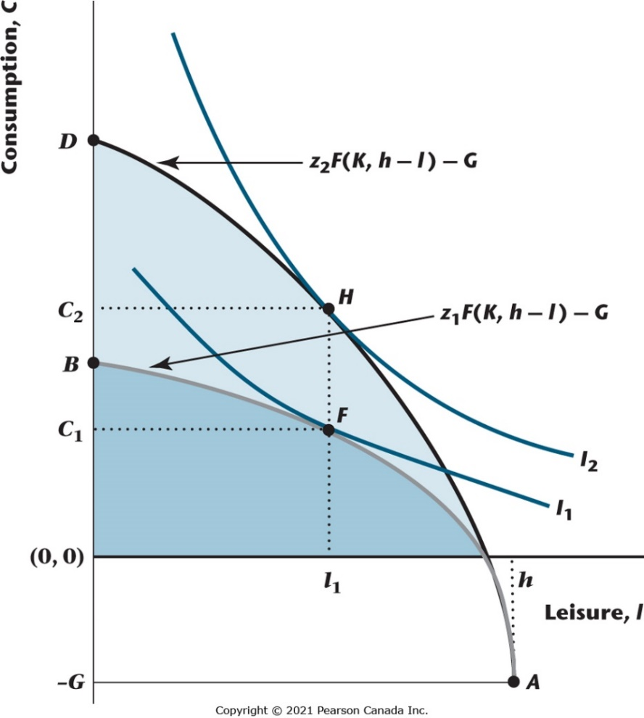
Figure 5.8 Competitive Equilibrium Effects of an Increase in Total Factor Productivity
An increase in total factor productivity shifts the PPF from AB to AD. The competitive equilibrium changes from F to H as a result. Output and consumption increase, the real wage increases, and leisure may rise or fall. Since employment is N = h - l, employment may rise or fall.

Slide 20
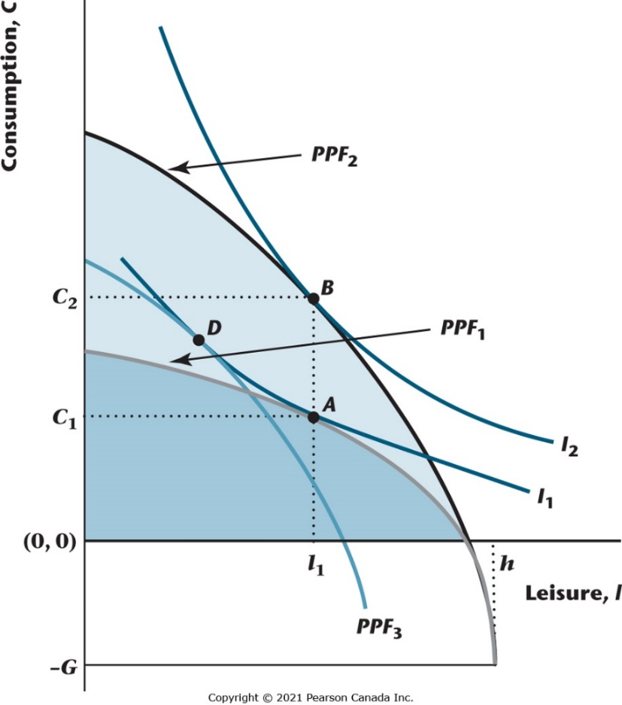
Figure 5.9 Income and Substitution Effects of an Increase in Total Factor Productivity
Here, the effects of an increase in total factor productivity are separated into substitution and income
effects. The increase in total factor productivity involves a shift from PPF₁ to PPF₂. The curve PPF₃ is an artificial PPF, and it is PPF₂ with the income effect of the increase in z taken out. The substitution effect is the movement from A to D, and the income effect is the movement from D to B.

Slide 21
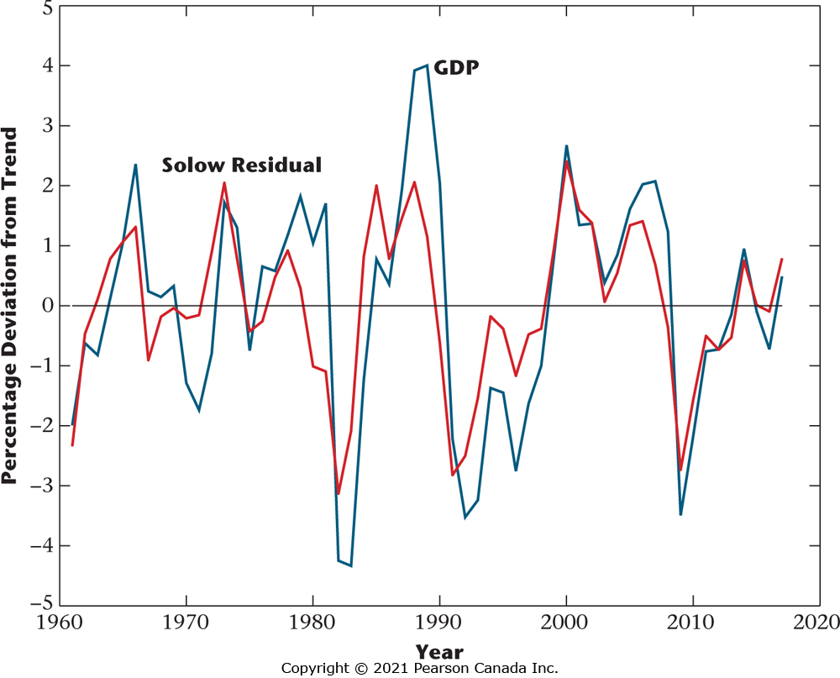
Figure 5.11 Deviations from Trend in the Solow Residual and Real GDP, 1961–2017
The figure shows the percentage deviations from trend in the Solow residual, a measure of total factor productivity, and in real GDP. The two time series track each other very closely, consistent with the view that total factor productivity fluctuations are an important cause of business cycles.

Slide 22
A Simplified Model with a Proportional Income Tax
Use the model to study the incentive effects of the income tax, and to derive the “Laffer curve.”

Slide 23

Production Function Without Capital
Labour is the only input, but there is still constant returns to scale (linear production function).
$$Y=zN$$

Slide 24
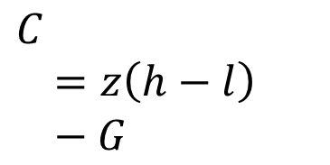
Production Possibilities Frontier
$$C=z\left(h−l\right)−G$$

Slide 25

Consumer’s Budget Constraint
$$C=w\left(1−t\right)\left(h−l\right)+π$$

Slide 26

Profits for the Firm
$$π=Y−wN^{d}=\left(z−w\right)N^{d},$$

Slide 27

The Consumer’s Budget Constraint in Equilibrium
$$C=z\left(1−t\right)\left(h−l\right).$$

Slide 28
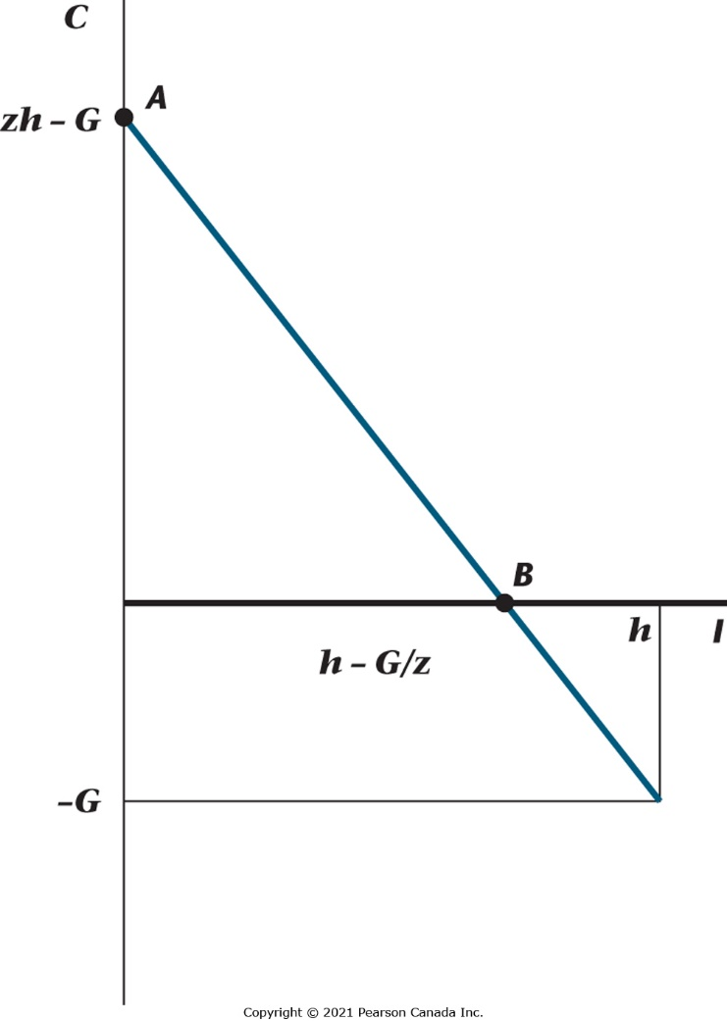
Figure 5.12 The Production Possibilities Frontier in the Simplified Model
The production possibilities frontier is linear. The maximum quantity of consumption (when the quantity of leisure is zero) is zh - G.

Slide 29

Revenue for the Government Given the Tax Rate t
$$REV=tz\left[h−l(t)\right]$$

Slide 30
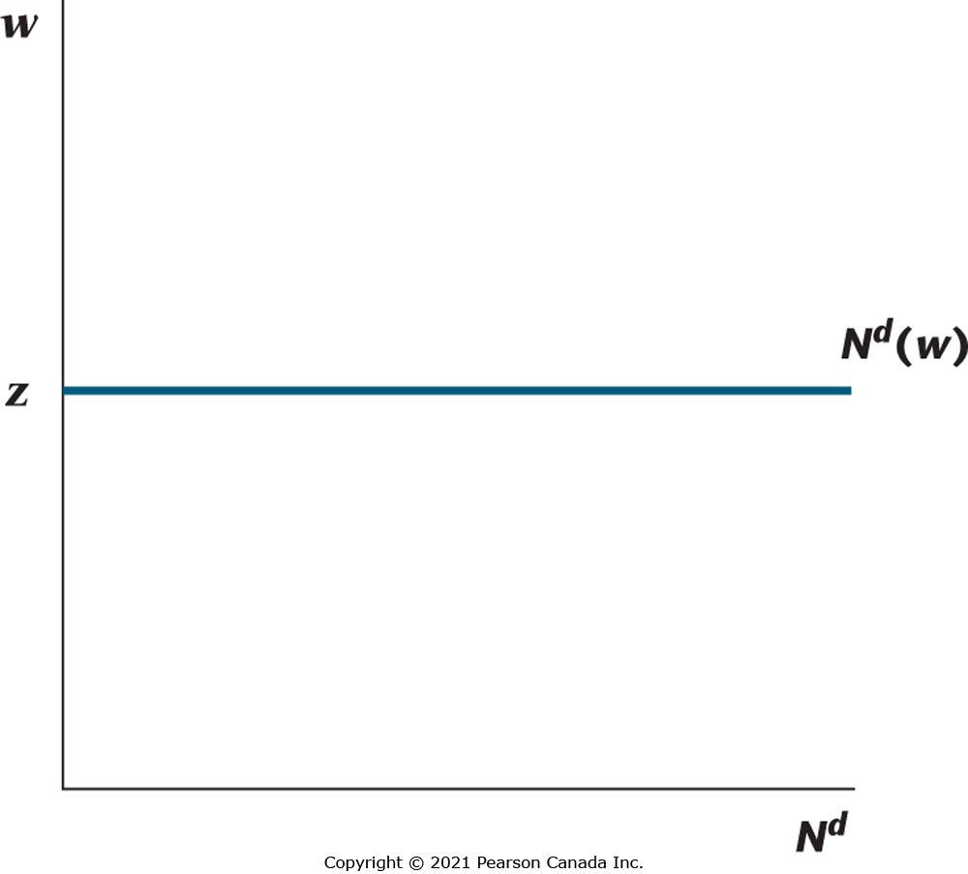
Figure 5.13 The Labour Demand Curve in the Simplified Model
Since productivity is constant at z, the representative firm’s demand curve for labour is infinitely elastic at w = z.

Slide 31
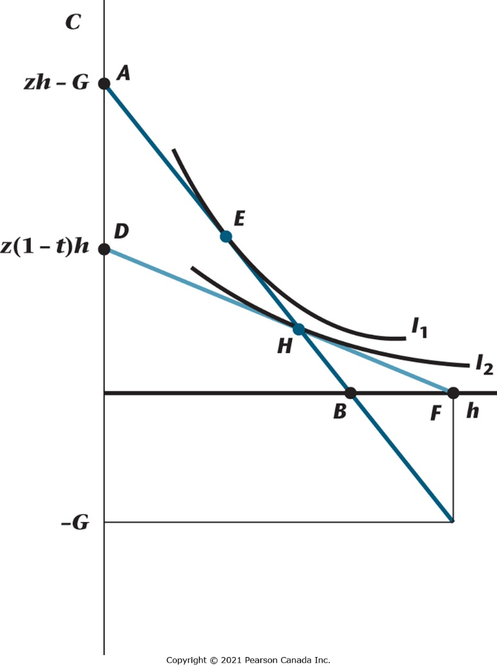
Figure 5.14 Competitive Equilibrium in the Simplified Model with a Proportional Tax on Labour Income
The competitive equilibrium is point H, and the Pareto optimum is point E.

Slide 32
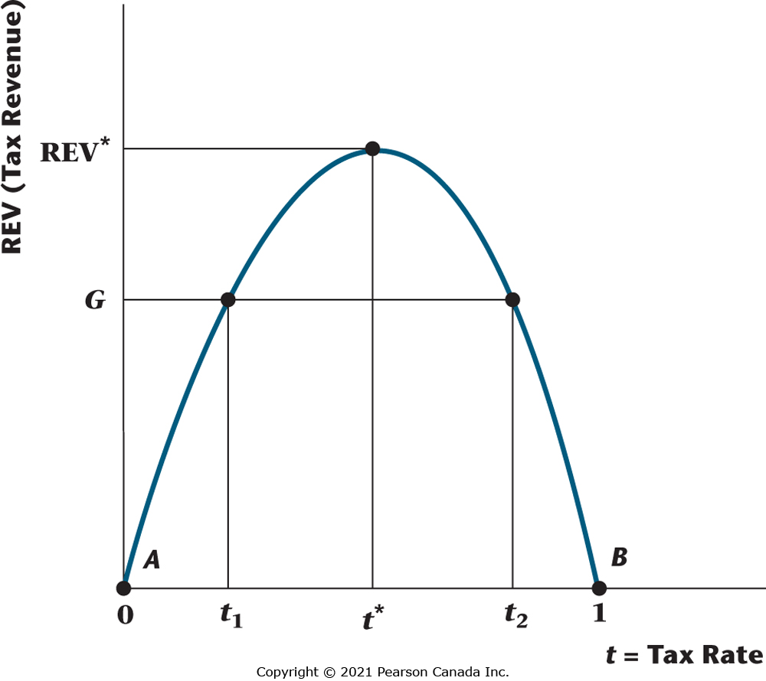
Figure 5.15 A Laffer Curve
The Laffer curve is the relationship between income tax revenue and the income tax rate. Tax revenue must be zero when t = 0 (the tax rate is zero) and t = 1 (because no one will work if all income is taxed away). The government can maximize tax revenue by setting t = t*. If the government wishes to finance government spending equal to G, it can set a tax rate of t₁ (on the good side of the Laffer curve) or t₂ (on the bad side of the Laffer curve).

Slide 33
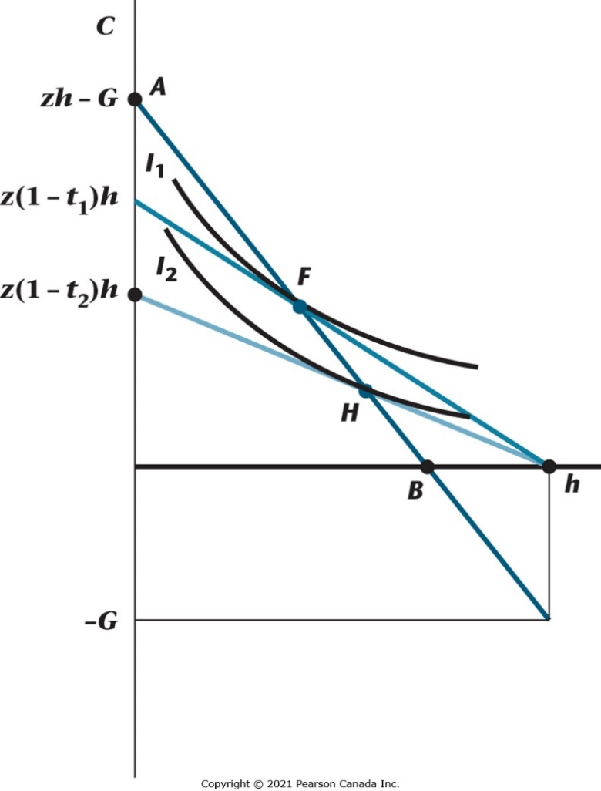
Figure 5.16 Equilibria with High and Low Tax Rates
Given government spending equal to G, as in Figure 5.15, there are two equilibrium tax rates. The low-tax-rate (high-tax-rate) equilibrium is at point F (H). In the low-tax-rate equilibrium, consumption and output are higher and leisure is lower than in the high-tax-rate equilibrium.

Slide 34
Keynesian Sticky Wages and Prices
In the basic closed-economy one-period macroeconomic model, prices are assumed to be perfectly flexible, and quantity supplied is equal to quantity demanded in each market in equilibrium.
Long tradition in macroeconomics, dating back to Keynes’s General Theory, taking seriously the idea that prices and wages are sticky.
Why might prices and wages be sticky?
Costs associated with decision-making to change wages or prices – labour negotiations about wages, or executive decisions on price changes. adiq increases – can produce more G for a given input of private goods.
Evidence of stickiness: Prices and wages change infrequently.

Slide 35
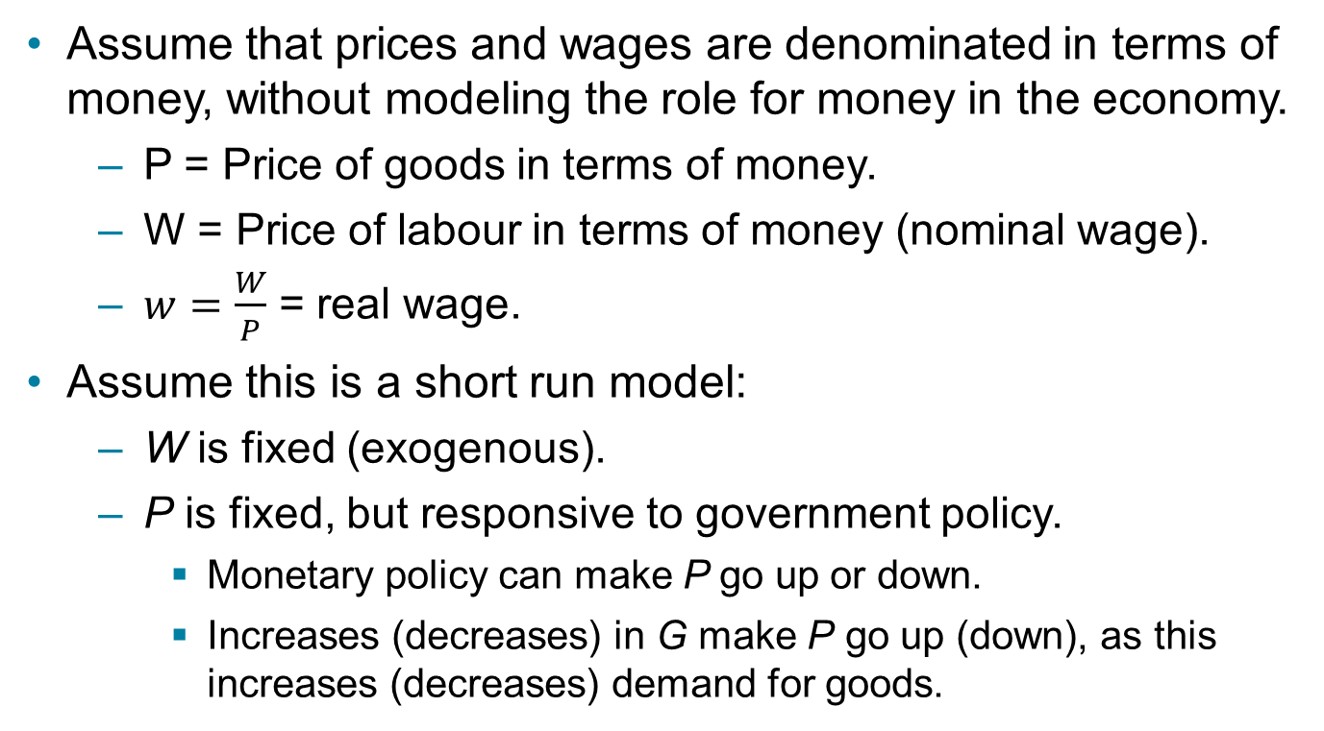
Modifying the Basic Model to Include Wage and Price Stickiness
Assume that prices and wages are denominated in terms of money, without modeling the role for money in the economy.
P = Price of goods in terms of money.
W = Price of labour in terms of money (nominal wage).
$w=\frac{W}{P}$ = real wage.
Assume this is a short run model:
W is fixed (exogenous).
P is fixed, but responsive to government policy.
Monetary policy can make P go up or down.
Increases (decreases) in G make P go up (down), as this increases (decreases) demand for goods.

Slide 36
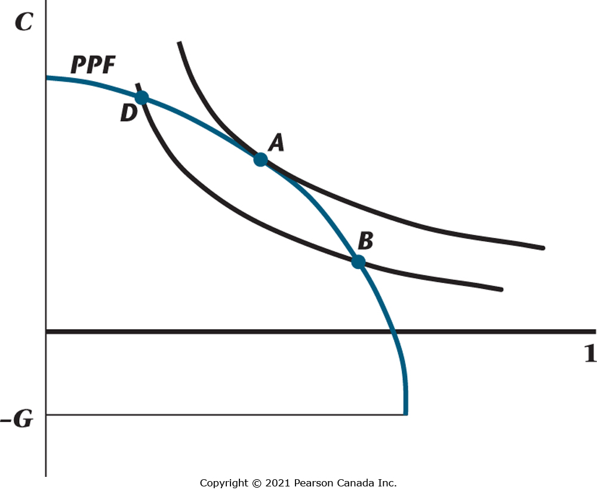
Figure 5.17 Short Run Equilibrium with Sticky Wages and Prices
A represents an efficient state of affairs. If the real wage is too low, the short-run equilibrium is at a point such as B, where there is an excess supply of labour. At point C, the real wage is too high, and the consumer is working more than he or she would like at the market wage.

Slide 37
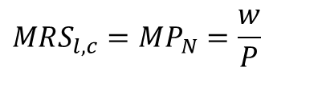
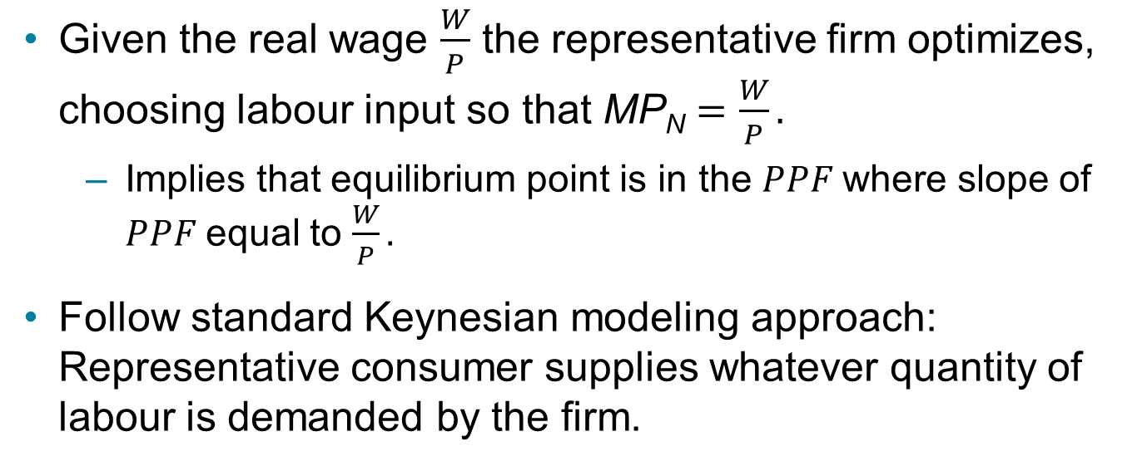
Equilibrium with Price and Wage Stickiness (1 of 2)
Given the real wage $\frac{W}{P}$ the representative firm optimizes, choosing labour input so that $\text{MP}\text{N}=\frac{W}{P}.$
Implies that equilibrium point is in the $PPF$where slope of $PPF$equal to $\frac{W}{P}.$
Follow standard Keynesian modeling approach: Representative consumer supplies whatever quantity of labour is demanded by the firm.
$$MRS_{l,c}=MP_{N}=\frac{w}{P}$$
Efficient output:

Slide 38
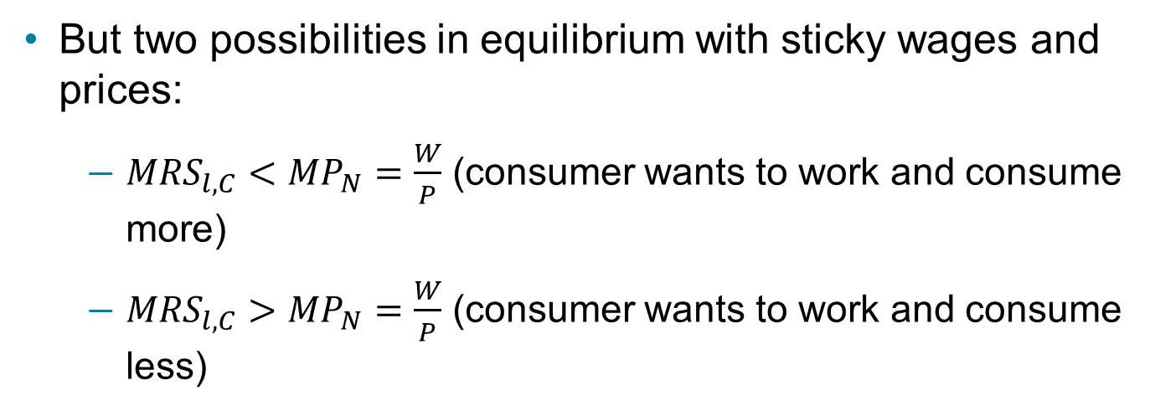
Equilibrium with Price and Wage Stickiness (2 of 2)
But two possibilities in equilibrium with sticky wages and prices:
${MRS}_{l,C}<{MP}_{N}=\frac{W}{P}$ (consumer wants to work and consume more)
${MRS}_{l,C}>{MP}_{N}=\frac{W}{P}$ (consumer wants to work and consume less)

Slide 39
Macroeconomic Policy with Sticky Wages and Prices (1 of 2)
In general, the competitive equilibrium is not Pareto optimal – the first welfare theorem fails.
In the long run, prices and wages adjust so that efficiency is achieved.
Keynesians argue that the long run is too long to wait. Keynes said: “In the long run we are all dead.”

Slide 40
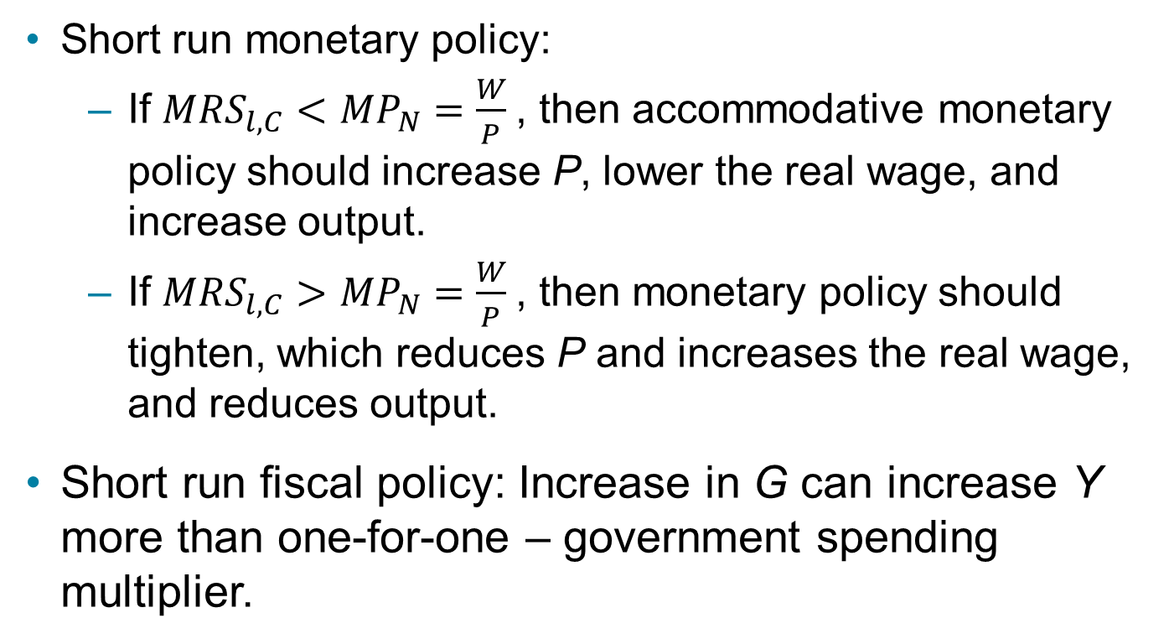
Macroeconomic Policy with Sticky Wages and Prices (2 of 2)
Short run monetary policy:
If ${MRS}_{l,C}<{MP}_{N}=\frac{W}{P}$, then accommodative monetary policy should increase P, lower the real wage, and increase output.
If ${MRS}_{l,C}>{MP}_{N}=\frac{W}{P}$, then monetary policy should tighten, which reduces P and increases the real wage, and reduces output.
Short run fiscal policy: Increase in G can increase Y more than one-for-one – government spending multiplier.

Slide 41
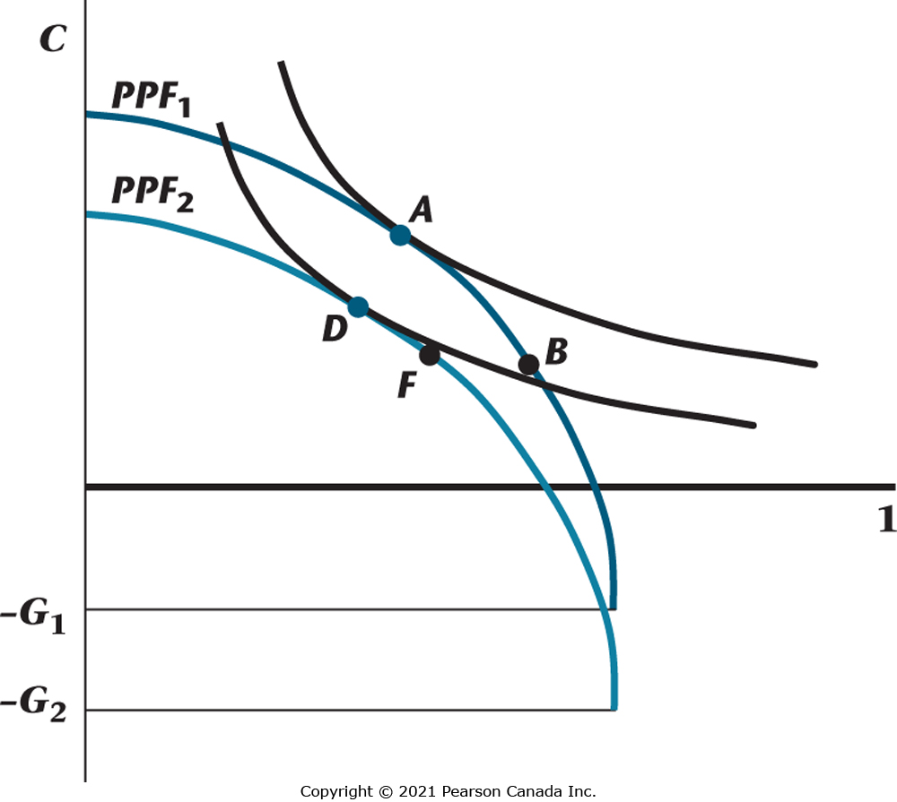
Figure 5.18 An Increase in Government Spending with Sticky Wages and Prices
In this example, government spending increases the price level P and reduces the real wage. The PPF shifts in the usual fashion, but the equilibrium shifts from B to F, increasing consumption.

